Slide 1
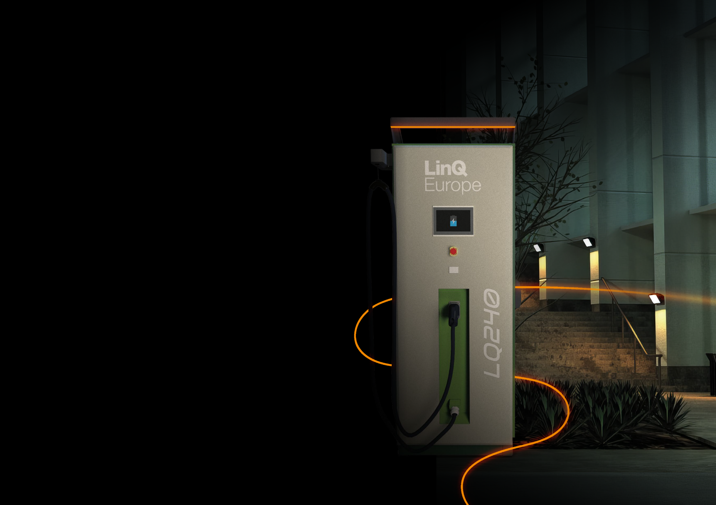
Prepare your car park
for the future
Provide charging stations for the increasing number of electric vehicles

Slide 2
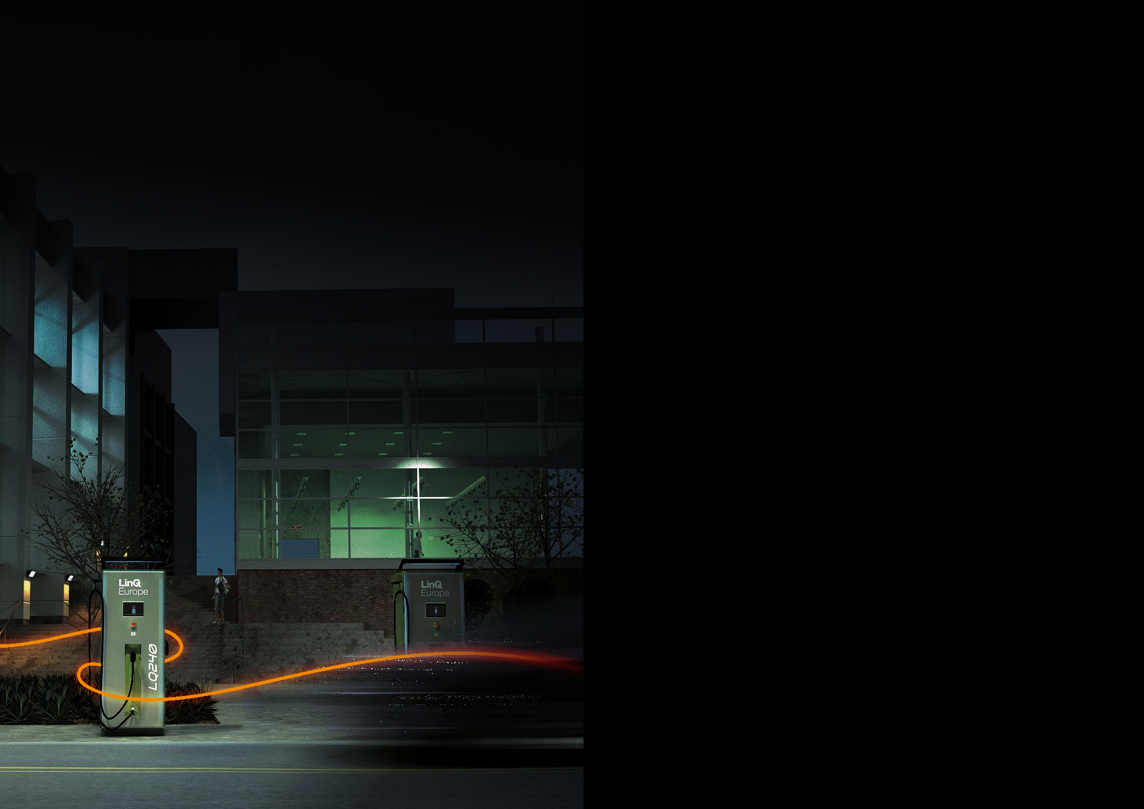
Invest in charging stations and attract more customers
At MTe Solutions, we provide premium DC chargers, enabling customers to charge their electric vehicles quickly,
safely and easily. MTe Solutions stands for years
of experience in the electrical industry in various areas. Now, we use our experience in DC charger production — providing uncompromised quality, confirmed with certification, tests, and recommendations.
Our team consists of a group of highly qualified engineers — realising professional solutions to meet the expectations
of our customers.
Why choose DC-series?
Highly efficient car charging! Charging within 30 minutes or even less for LQ240 models with the right external conditions and vehicle technology
Scalable Power starting from 40 kW
European Production
Future-proof for using with high Voltage Battery Technology (up to 1000 V)
Quality confirmed by ISO 9001:2015 Certification

Slide 3
DC-series — a full spectrum of benefits
Efficient and Fast Charging: 30 minutes maximum, under the right conditions!
By choosing the highest power,
you provide customers with high-speed charging in just 30 minutes, given
the right external (like temperature) and technical conditions of the vehicle.
This option sets you apart in the market!
Safety is the foundation of trust. We care about both
The LQ-series meets all requirements and standards: overcurrent protection, overvoltage protection, short-circuit protection, residual current protection, undervoltage protection, isolation monitoring, ground fault protection.
Wide temperature range
LQ-series operate reliably across
an extensive temperature range, ranging from -25°C to +50°C. Furthermore, storing the chargers prior to installation is also safe in this temperature range.
User-Friendly: details that enhance the customer experience
The standard version includes a 5 m cable, with a cable guiding system and a Start/Stop system with RFID or a mobile app.
As a result, the operation becomes incredibly easy and trouble-free.
Perfect communication with well-known platforms
Build on the open standard, the use of the appropriate OCPP protocol allows you to cooperate with charging services
provided by leading European companies.
Prompt return on investment
By determining your own rates
and taking advantage of cross-selling opportunities, you can optimize your income and quickly recoup your investment.

Slide 4
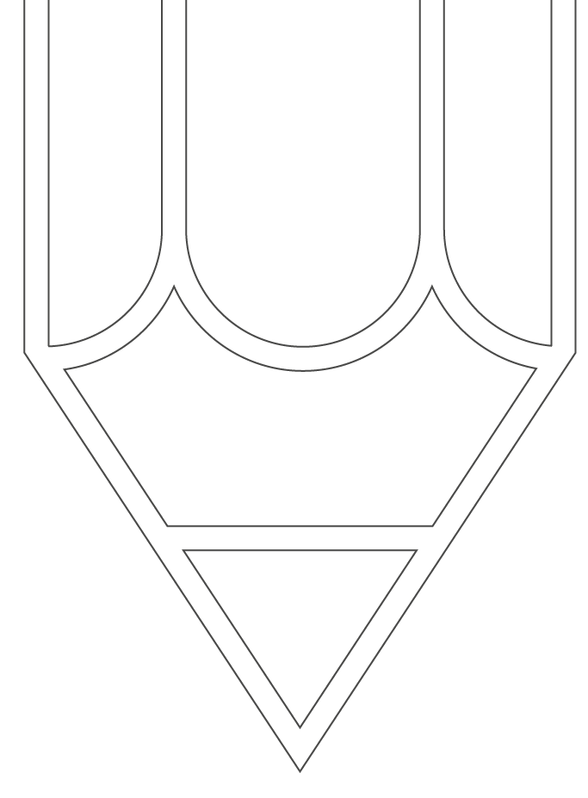
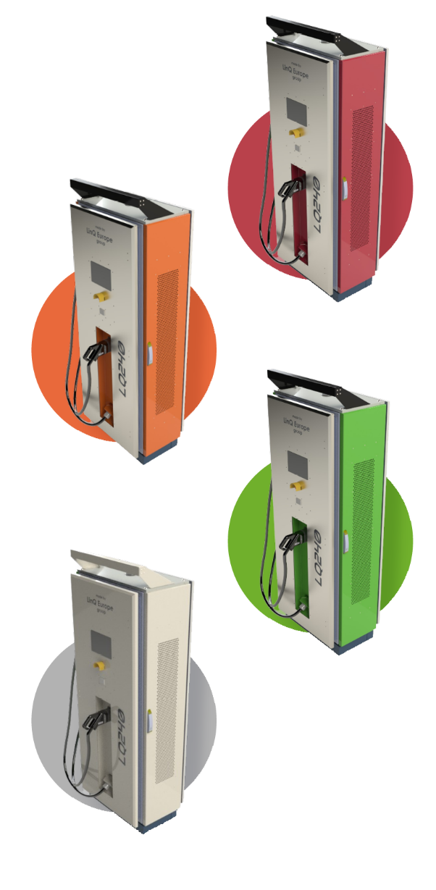
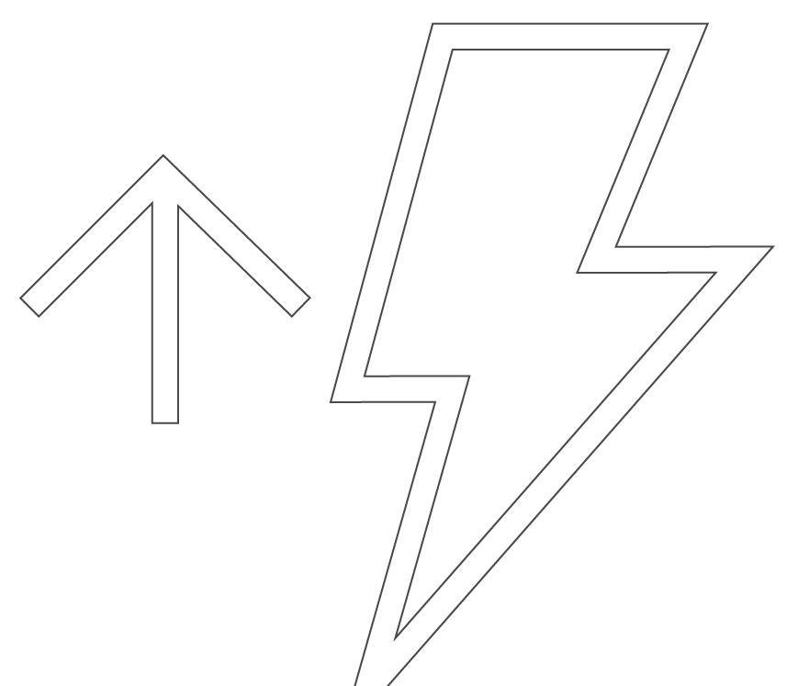
DC-series tailored to your business
Scalability: Modular design allows for individual charger power adjustment
Thanks to the modular design, there is the possibility of flexible power scaling. This is achieved through 40 kW power modules inside the devices, the quantity of which you can increase.
In doing so, you boost the power and reduce charging time. This is highly cost-effective — you don’t need to order a new device, just adjust.
The power range starts at 40 kW and goes up to 240 kW.
Customize the panels all around: front, back and sides
Chargers with custom adjustments:
put your logo,
change panel’s colours,
adjust the lighting.
This not only provides new advertising space but also integrates the station seamlessly into your brand and business environment.
Promote charging stations in your marketing materials to tap into the booming electric car market and expand your customer base.

Slide 5
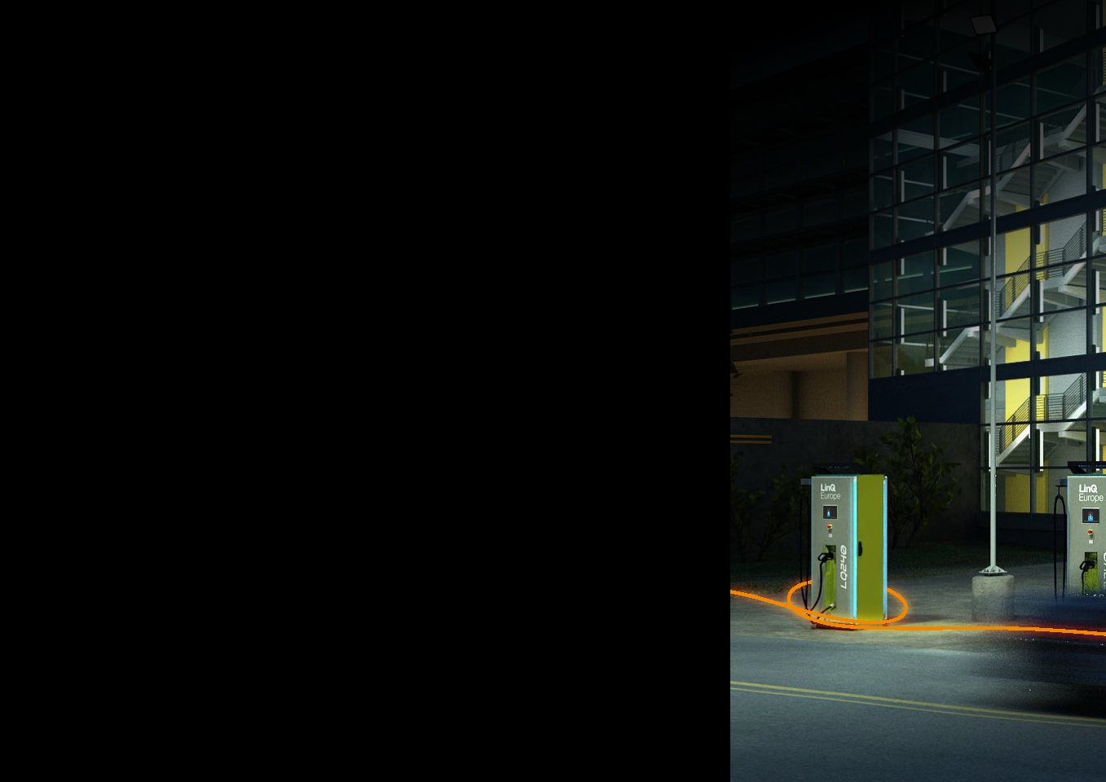
Trust certified quality
We check each charger before we send it to our customers — we test it on a dedicated, certified device and we only sell proven products!
What's more, our prototypes passed the tests flawlessly at the very first run! This is extremely rare in this type of advanced solutions. Mte Solutions always confirms the quality of it's products in internal quality tests.
Furthermore, the external tests have confirmed a maximum charging time of 30 minutes for the LQ240 model, with the right external conditions and vehicle technology.
The factory is ISO 9001:2015 certified, which confirms the controlled maintenance of internal processes and the readiness to improve
every operation. In the annual external audits, we gain
high marks, which proves that we maintain our processes at a high level daily. As a result, the products we offer are reliable.
Our in-house quality is reinforced by components from top manufacturers.
Safety is our top priority, and efficiency is crucial. The high quality
of our DC fast chargers ensures both.

Slide 6
Choose a charger that meets customers’ expectations
Tailor the charging station’s power
and functionality to suit your business needs! Choose between power ranging from
40 to 240 kW and multiple additional options.
High standard version
Modular scalable power, starting from 40kW
Heating elements × 2
Fans × 2
"10 touch screen
Standard length charge cable: 5 meters
Guiding charge cable
Compatible with almost each European Platform
Sleep mode in non-active stand (safe energy)
Future proof design till 1000 V use
Improve your device via options:
Version 2 — 2 DC pistols + load balance
Version 3 — 2 DC pistols + 1 AC pistol + load balance
Version 4 — 1 DC pistol + 1 AC pistol +load balance
Payment terminal, CE approved
Mounting socket in concrete or metal
MID DC Meter (eichrecht)
HALO lighted
On request — no touch screen

Slide 7
Specification
Input
Output
AC Connection | 3P + N +PE
AC Voltage | 400VAC +/- 10%
Frequency | 50 – 60Hz
Nominal Current | 390A max
Power Factor | 0.99
DC Output Voltage Range | 150 V – 1000 V
Maximum Charging Current | 250 A
Maximum Charging Power | 240 kW
CCS2 Cable and Connector Rating | 250 A
CCS2 Compliance | IEC 61851-23 /-24, IEC 62196-3, DIN 70121
Cable Length | 5 m (standard)
General
Efficiency | 96%
Operating Temperature | -25°C to +50°C
Storage Temperature | -40°C to +80°C
Humidity | <95% relative humidity, non condensing
Ingress Protection | IP55
Mechanical Impact Protection | IK10
Cooling | Forced air
Compliance | CE, LVD 2014/35/UE, EMC 2014/30/UE, RED 2014/53/UE
Protections
Overcurrent protection | ✓
Overvoltage protection | ✓
Shortcircuit protection | ✓
Residual current protection | ✓
Undervoltage protection | ✓
Isolation monitoring | ✓
Ground fault protection | ✓
 | LQ40 | LQ80 | LQ120 | LQ160 | LQ200 | LQ240
Power input | 400 V / 65 A | 400 V / 130 A | 400 V / 195 A | 400 V / 260 A | 400 V / 325 A | 400 V / 390 A
Power output | 40 kW | 80 kW | 120 kW | 160 kW | 200 kW | 240 kW
Weight | 300 – 470 kg | 300 – 470 kg | 300 – 470 kg | 300 – 470 kg | 300 – 470 kg | 300 – 470 kg
Dimensions (H×D×W) Height with Halo | 2000×600×800 mm | 2000×600×800 mm | 2000×600×800 mm | 2000×600×800 mm | 2000×600×800 mm | 2000×600×800 mm

Slide 8
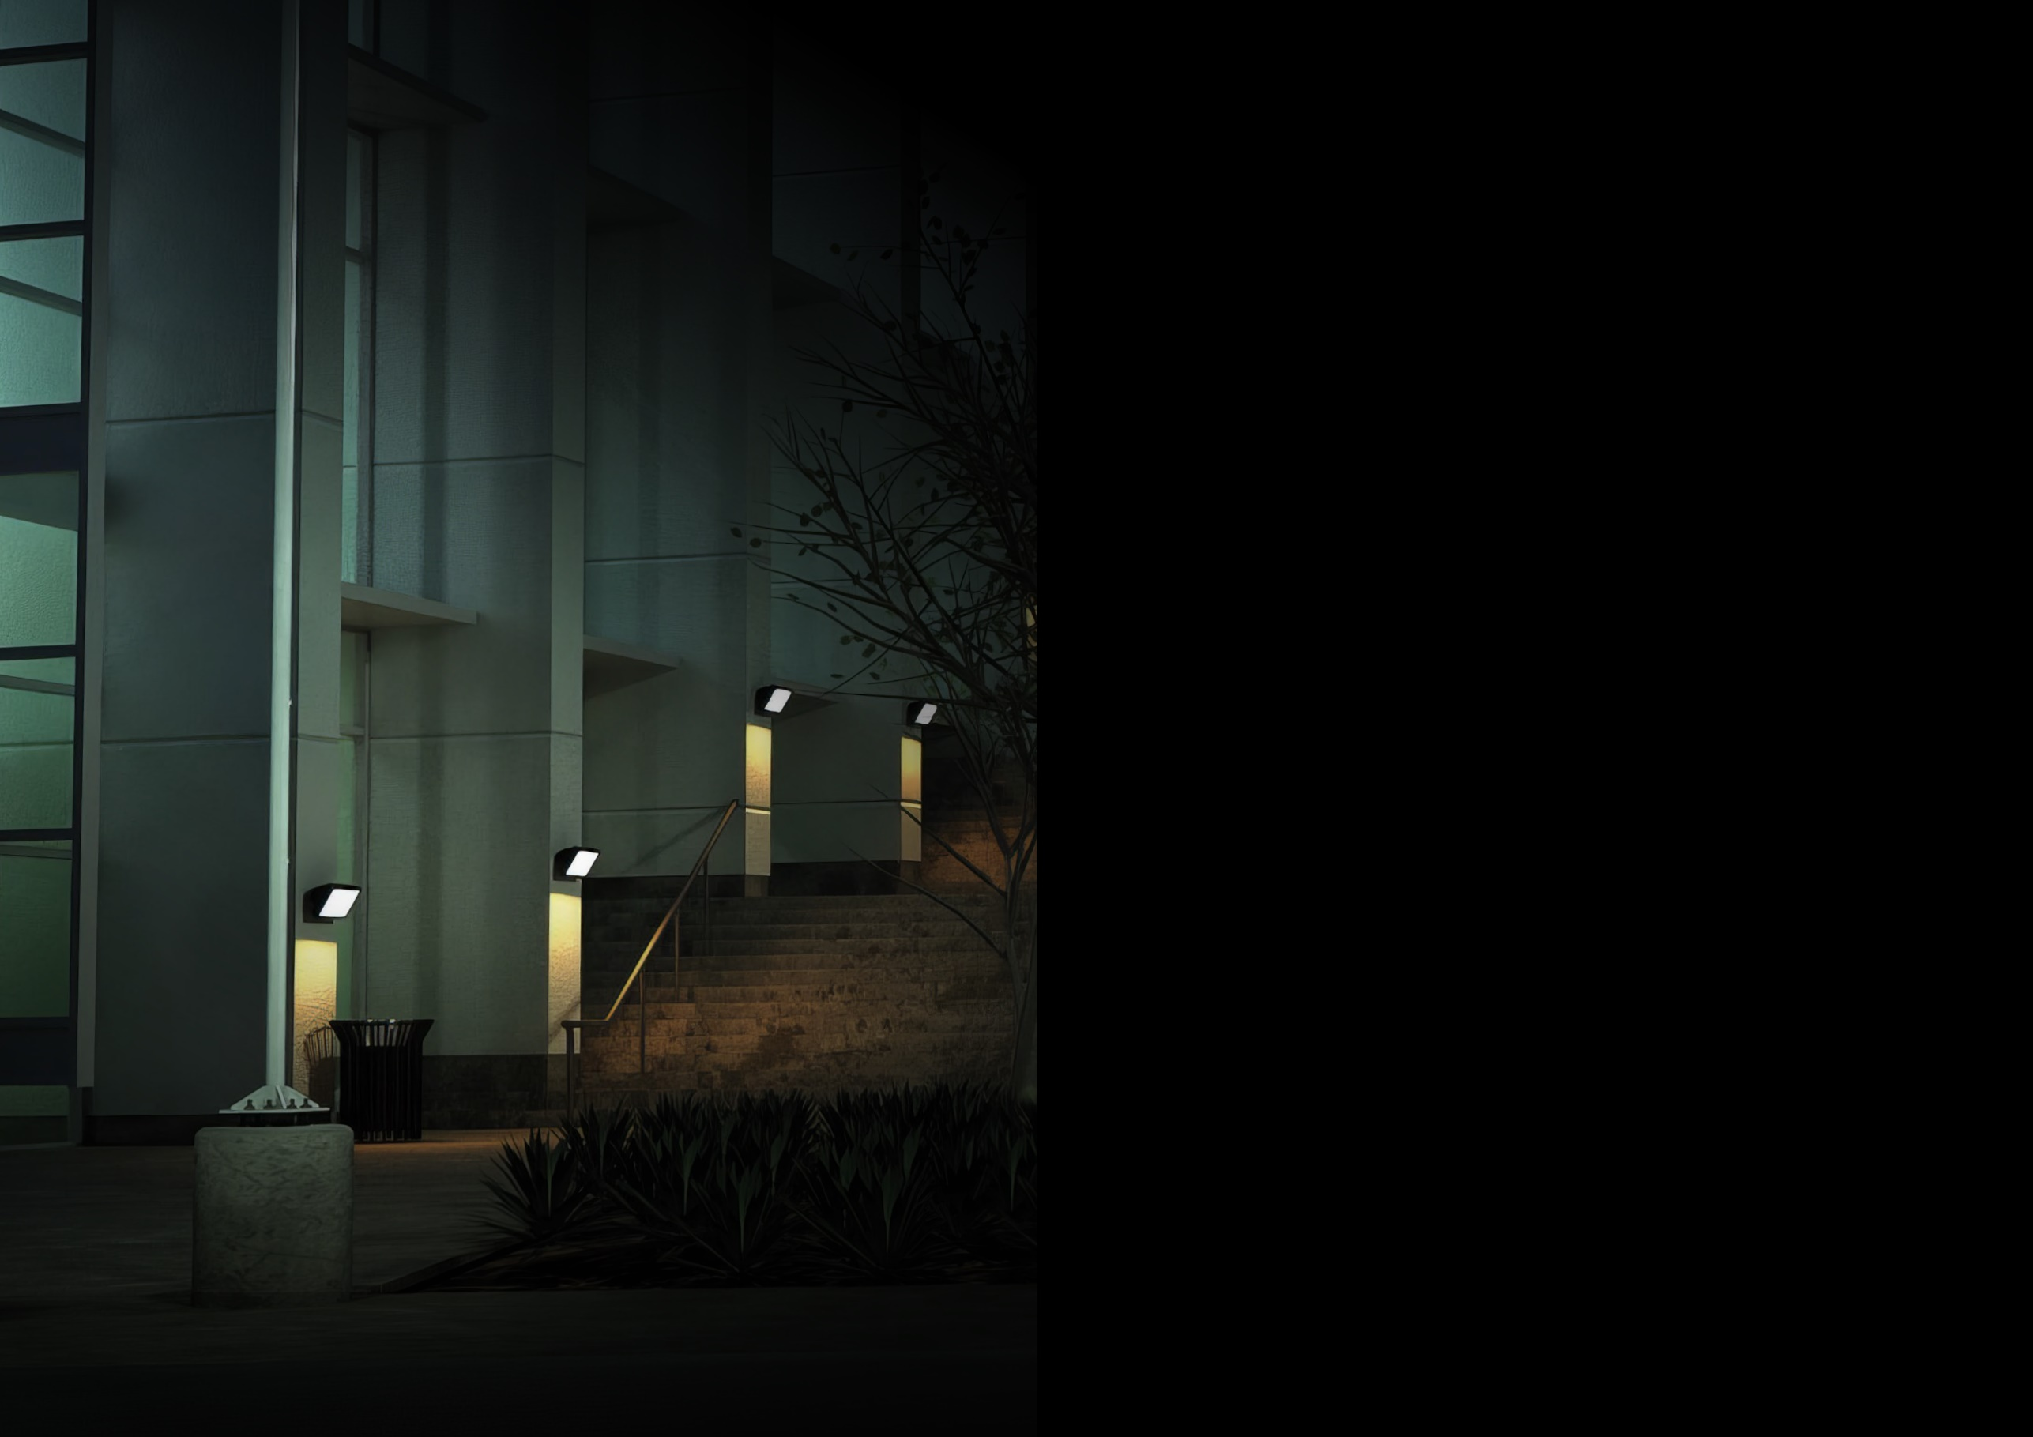
Flexible company who reacts fast to clients’ needs
Contact us
E-mail: info@MTeSolutions.eu
Phone: +32 456 40 50 88
Learn more about the features of LQ-series

